Slide 1
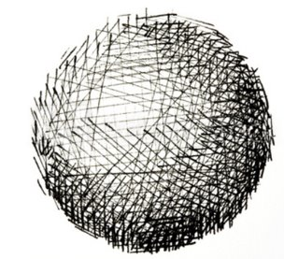
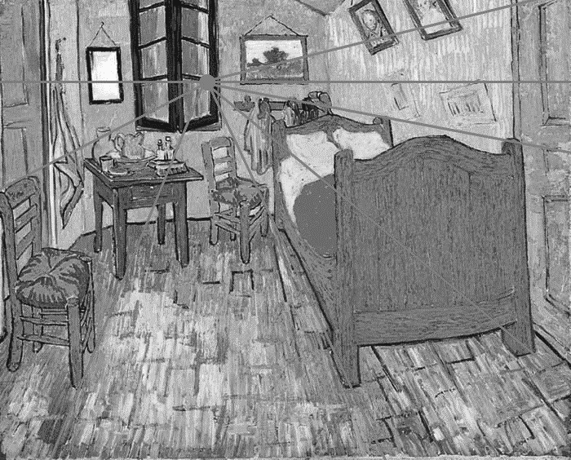
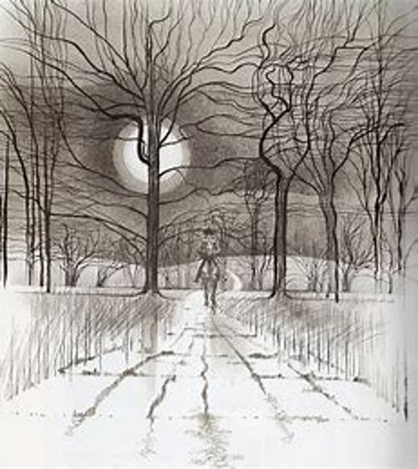
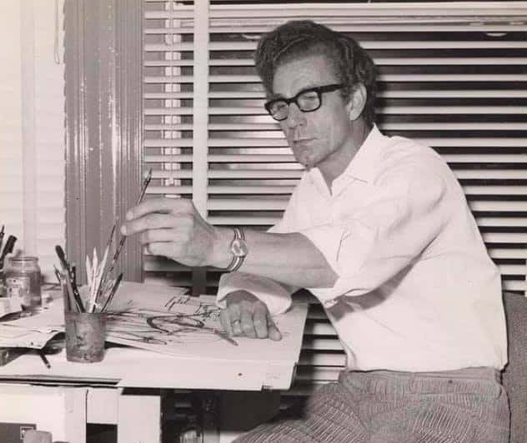
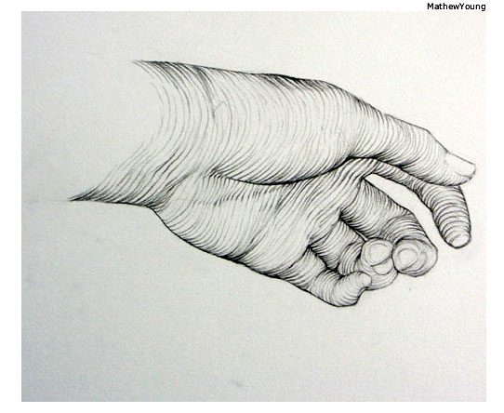
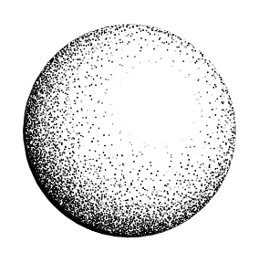
Year 5 Art: Observational Drawing
Key Questions
How has Charles Keeping used line to show light and dark shades in his composition?
What do you notice about the lines in his work? Would he gain the same effect if he used colour?
How would you develop your ideas further?
Knowledge
·Build on previous learning on perspective.
Become familiar with the work of Charles Keeping.
Know the many different types of hatching that is used in enhancing light and shade.
Use understanding of the extracts from the poem to create composition.
Skills
Work in a sustained and independent way to create detailed drawing.
Use a sketchbook to collect and develop ideas.
Use different techniques for different purposes e.g. cross-hatching techniques to enhance light and dark.
Begin to use simple perspective in drawings such as vanishing point and horizon line.
Develop tonal drawing with use of pencil, charcoal and ink.
Develop an understanding of proportion within a composition.
Use ink blowing effectively to create lines.
Key Vocabulary | Definition
Observation | Drawing a subject by observing it in real life as opposed to using a photograph as reference.
Composition | A complete work of art. The way in which all its elements work together to produce an overall effect.
Tone | The lightness or darkness of something – this could be a shade, or how dark or light a colour appears
Shade | A shade is where an artist adds black to a colour to darken it down.
Cross-hatching | An artistic technique used to create tonal or shading effects by drawing closely spaced lines. When lines are placed at an angle to one another, it is called cross-hatching
Perspective | The art of representing three-dimensional objects on a two-dimensional surface so as to give the right impression of their height, width, depth, and position.
Vanishing Point | The point which is supposed to appear furthest from the viewer – where all parallel lines meets.
Proportion | Relationships between height, width and depth – describes parts of art relate to each other.
Contouring | Lines which define the edge of something.
Scumbling | A painting technique that involves applying a thin layer of paint over an existing layer.
Stippling | To draw or paint using dots or flicks.
Cross-hatching
Vanishing point/Perspective
Charles Keeping
Contouring
Stippling

